Slide 1
EcoFind Empowering Eco-Conscious Consumerism

Slide 2
Table of contents
01
02
03
04
Problem
Challenge
Solution
05
Impact
Summary

Slide 3
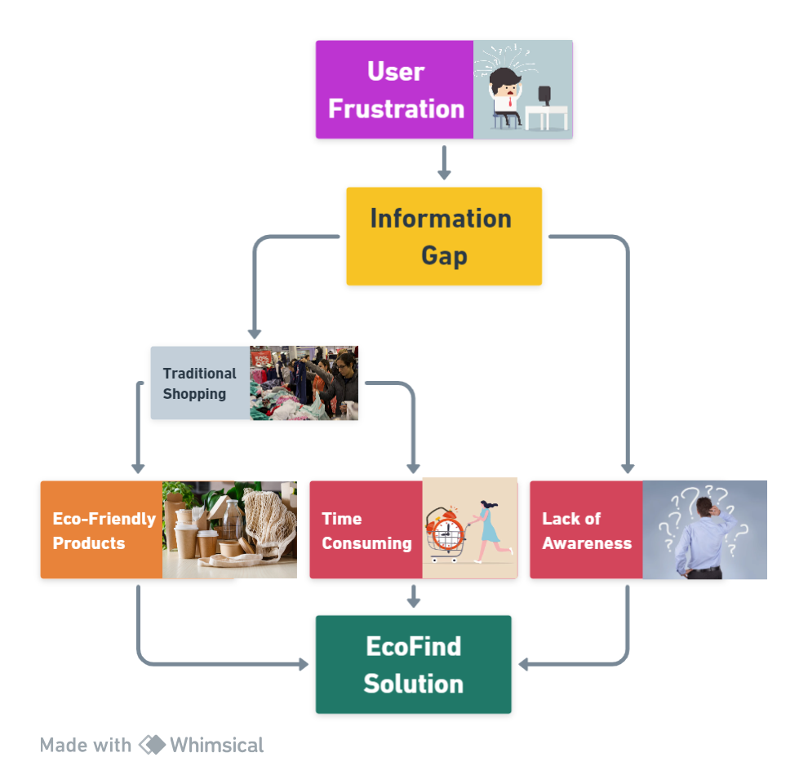
Problem Statement
The overwhelming variety of products on traditional e-commerce platforms makes it challenging for environmentally conscious individuals to find eco-friendly options quickly. This information gap hinders responsible consumer choices.

Slide 4
Challenge
Lack of awareness about sustainable alternatives and their benefits further complicates the adoption of eco-friendly living practices. Traditional stores may carry eco-friendly products, but they are often hidden, unreliable, and lack informative details, contributing to the awareness gap among consumers.

Slide 5
Solution
EcoFind addresses these challenges by curating and recommending eco-friendly products, simplifying the search process, and offering comprehensive product information. It also provides educational resources to bridge the knowledge gap on sustainable living.

Slide 6
Impact
EcoFind aims to encourage more people to embrace eco-conscious consumerism by making it easier to find and choose sustainable products. By raising awareness and simplifying the shopping experience, it contributes to a greener and more sustainable future.

Slide 7
Summary
Problem
Challenge
Difficulty finding eco-friendly products in a crowded market.
Lack of reliable sources and information gap.
Solution
Impact
EcoFind bridges the gap, curates eco-friendly options, and educates users.
Encouraging sustainable consumerism and raising awareness.

Slide 8
Tech Stacks Used:
Machine Learning:
Web Development:
Google Colab Environment
Pandas
Numpy
Sklearn
NLTK Library
Pickle
Streamlit
Python
Use of Pexels API
Git
Github
LFS
Methodology/Techniques:
Data Cleaning: Removing special characters, converting to lowercase, and splitting text into sentences.
Feature Engineering: Creating 'tags' by combining information from multiple columns.
Keyword Filtering: Identifying eco-friendly products using keywords.
Vectorization: Converting text into numerical vectors.
Cosine Similarity: Calculating similarity between products based on descriptions.
Product Recommendation: Recommending similar products based on input.
Serialization: Saving data for future use.

Slide 9
Thank You

